Slide 1
Text classification using K-Nearest Neighbors classifier
Dr. Kavita S. Oza

Slide 2
Steps in text classification
Importing Libraries
Importing the dataset
Text Pre-processing
Converting Text to Numbers
Training and Test Sets
Training Text Classification Model and making Prediction
Evaluating The Model

Slide 3

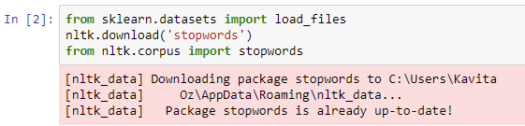
Importing Libraries
Use the load_files function from the sklearn_datasets library to import the dataset into application.

Slide 4

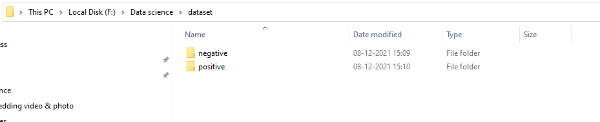
Loading Dataset
The load_files function automatically divides the dataset into data and target sets.
It treats each folder inside the “dataset" folder as one category and all the documents inside that folder will be assigned its corresponding category.
It loads the data from both "negative" and "positive" folders into the X variable, while the target categories are stored in y.

Slide 5
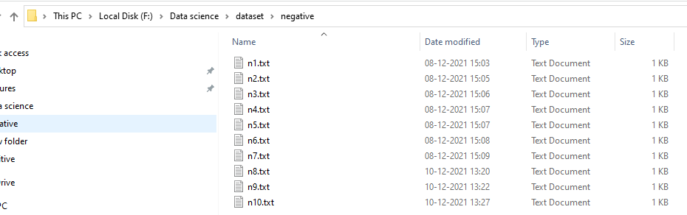
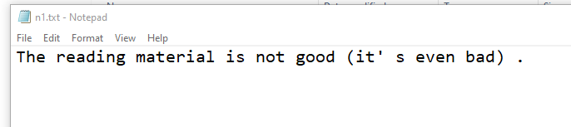
Dataset→ negative
X is a list of 20 string type elements where each element corresponds to single student feedback.
y is a numpy array of size 20.

Slide 6
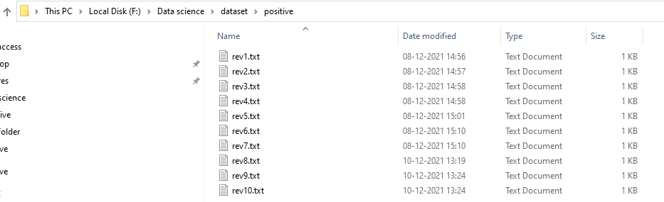
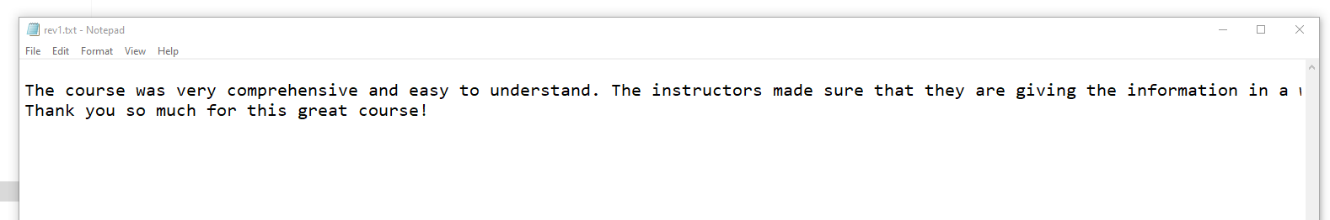
Dataset→ positive

Slide 7
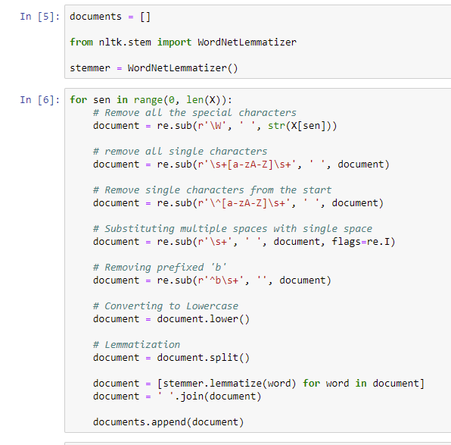
Text Pre-processing
India’s
India s
India s
India
cars
car

Slide 8
Converting Text to Numbers
Machines, unlike humans, cannot understand the raw text, but can see numbers.
Using statistical techniques, machine learning deal with numbers, need to convert text into numbers.
The Bag of Words Model and the Word Embedding Model are two of the most commonly used approaches.
In bag-of-words model , a text (such as a sentence or a document) is represented as the bag (multiset) of its words, disregarding grammar and even word order but keeping multiplicity.
Directly converting text documents into TFIDF feature values (without first converting documents to bag of words features)

Slide 9
Training and Testing Sets
Need to divide data into training and testing sets.
Use the train_test_split utility from the sklearn.model_selection library.
Divides data into 20% test set and 80% training set.

Slide 10


Training Model
Using the K-nearest neighbour classifier algorithm
Use KNeighborsClassifier from sklearn.neighbors library.
The fit method is used to train the algorithm.
Need to pass the training data and training target sets to this method.

Slide 11
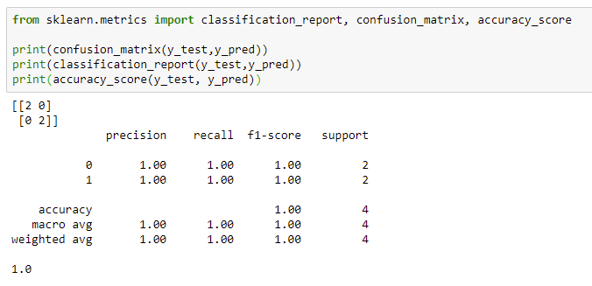
Evaluating the Model
Evaluation metrics such as the confusion matrix, F1 measure, and the accuracy.

Slide 12

Confusion Matrix
An N x N matrix used for evaluating the performance of a classification model, where N is the number of target classes.
The matrix compares the actual target values with those predicted by the machine learning model.
For a binary classification problem, have a 2 x 2 matrix
True Positive (TP) :
The predicted value matches the actual value. The actual value was positive and the model predicted a positive value
True Negative (TN):
The predicted value matches the actual value. The actual value was negative and the model predicted a negative value
False Positive (FP):
The predicted value was falsely predicted. The actual value was negative but the model predicted a positive value
False Negative (FN) :The predicted value was falsely predicted. The actual value was positive but the model predicted a negative value
Actual values
 | Positive | Negative
Positive | True positive (TP) | False Positive (FP)
Negative | False Negative (FN) | True Negative (TN)
Predicted
values
The target variable has two values: Positive or Negative
The columns represent the actual values of the target variable
The rows represent the predicted values of the target variable

Slide 13
Precision & Recall
Precision is the number of true positive results divided by the number of all positive results, including those not identified correctly.
Recall is the number of true positive results divided by the number of all samples that should have been identified as positive.
The F1 score is the harmonic mean of the precision and recall

Slide 14
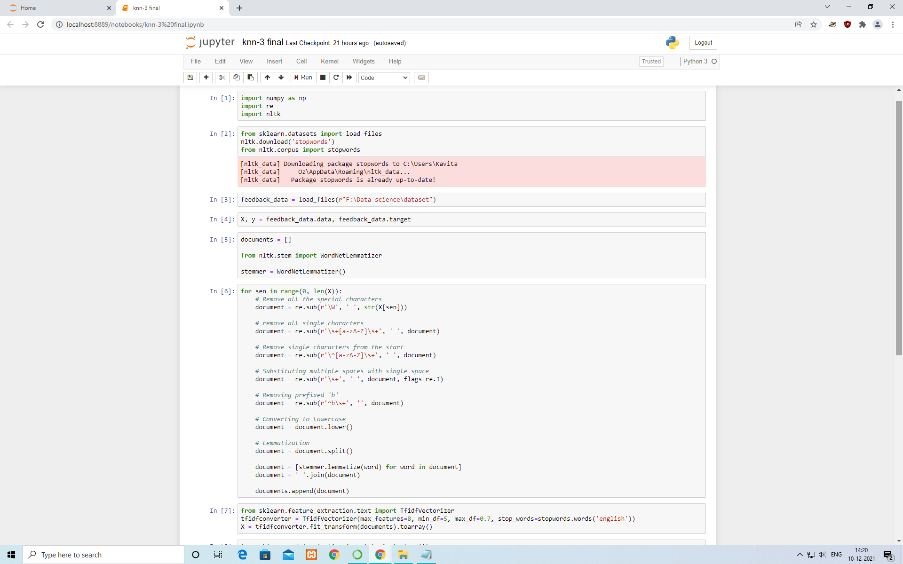
Program at a glance

Slide 15
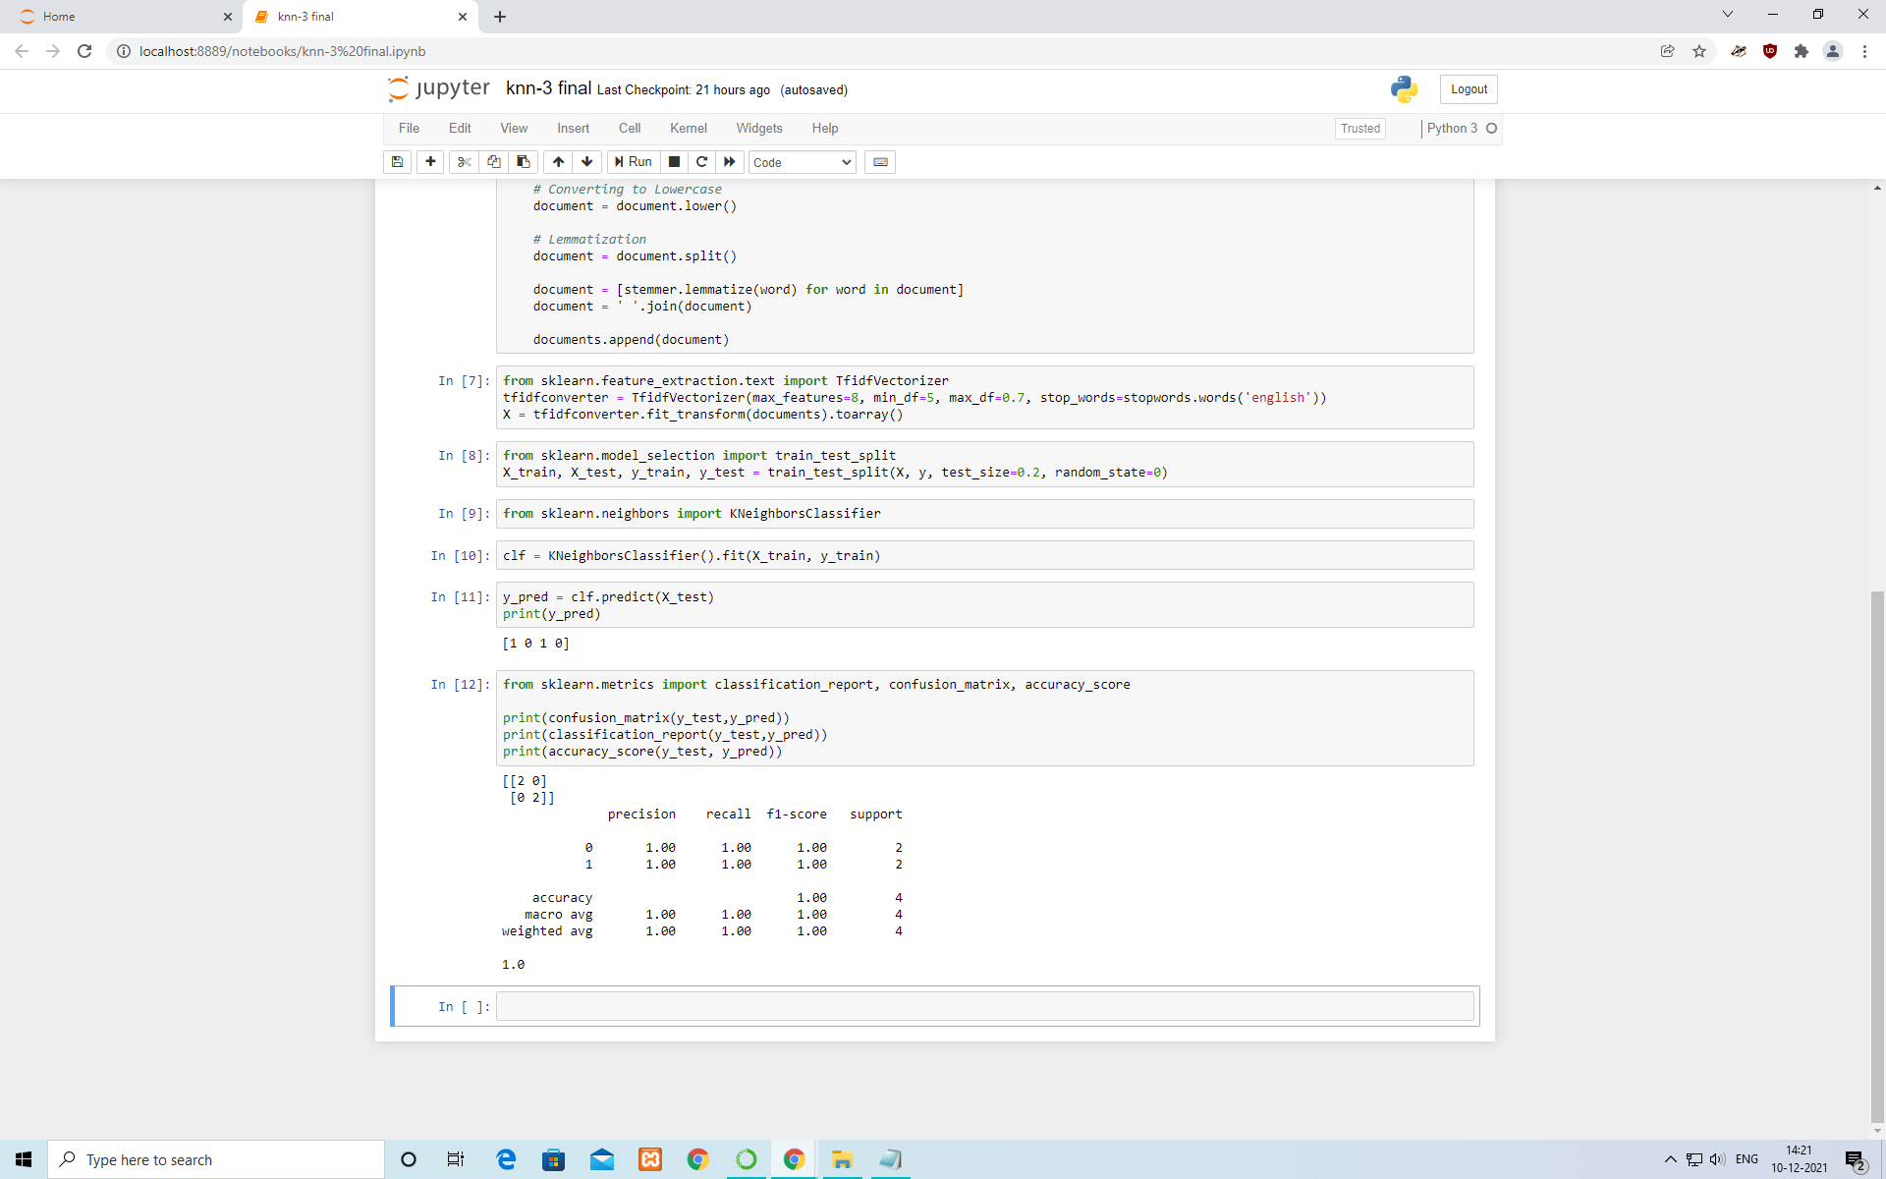
Program at a glance

Slide 16
Thank You

